Slide 1
Tasks Sessions
Github: https://github.com/abdlla-nasser/task-sessions
Abdallah Salem
Matriculation Number: 9210439

Slide 2
Project Purpose
Application is meant to help keeping track of user tasks and organize them according to user created categories and projects.
The user can for each task start a focus session (Pomodoro Technique) which starts a countdown timer and the duration of the timer can be specified by the user.
The user when creating a task, can specify how many expected focus session are needed to complete a task. And when he starts a focus session for a specific task the application keeps track of completed focus sessions for the task to help the user understand how he handles time estimation of tasks and set realistic goals for future tasks.

Slide 3
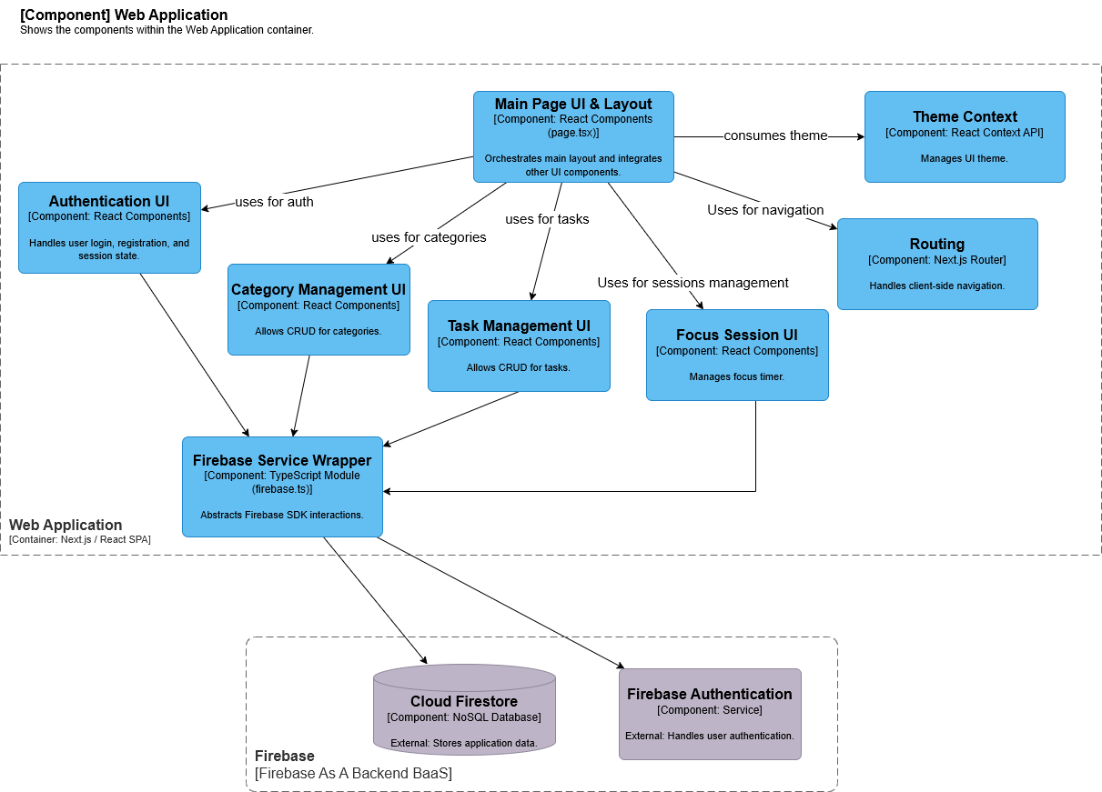
Architecture

Slide 4
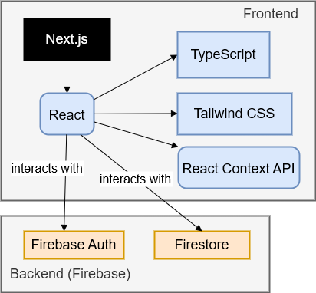
Technologies

Slide 5
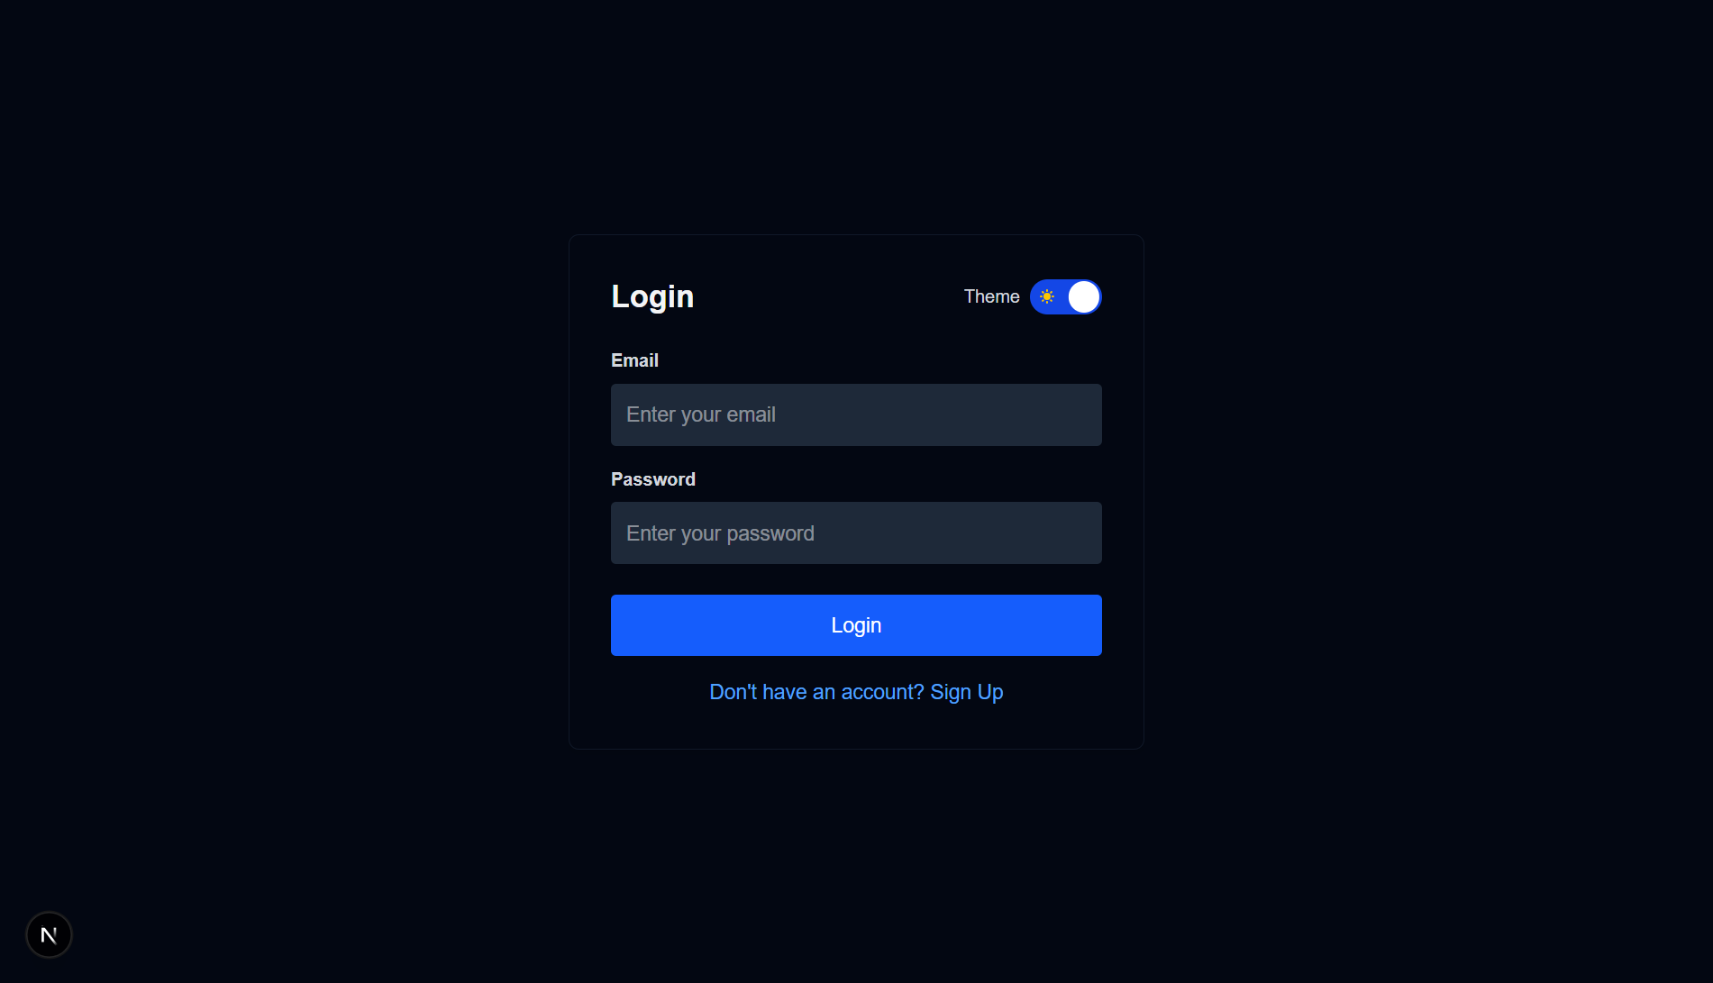
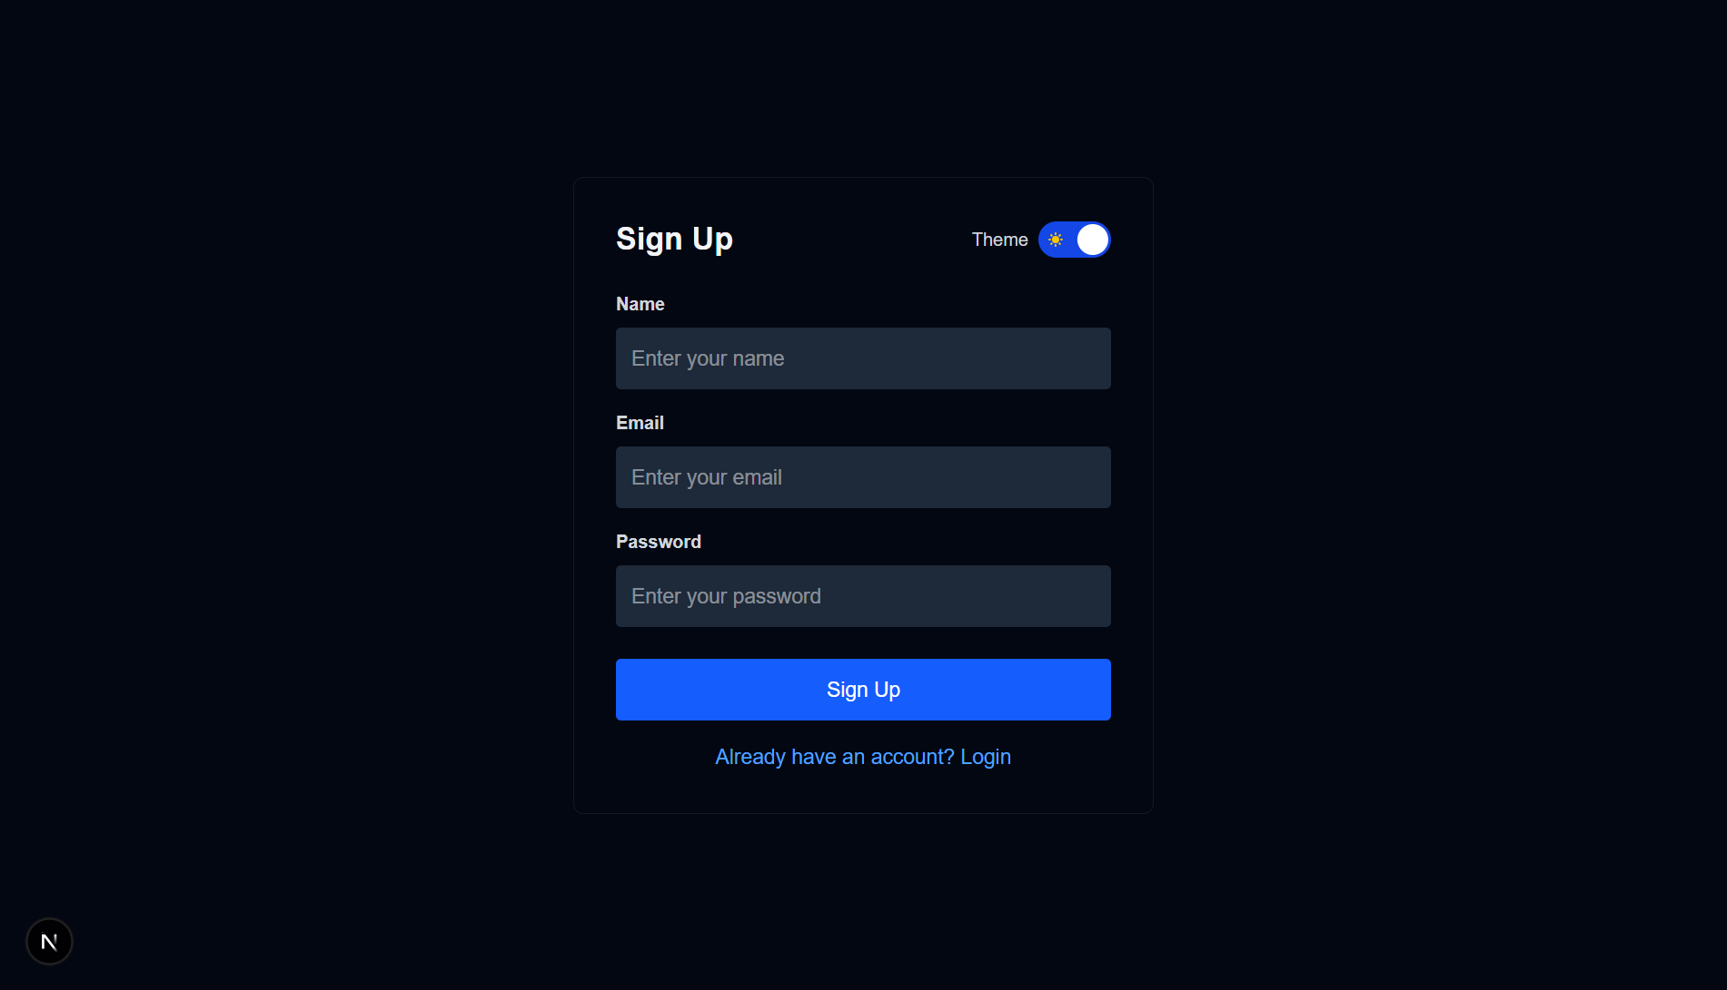
Login and Signup pages where a user enters his information and the app uses firebase authentication with email and password user creation and creates a user object and stores in firestore Database

Slide 6
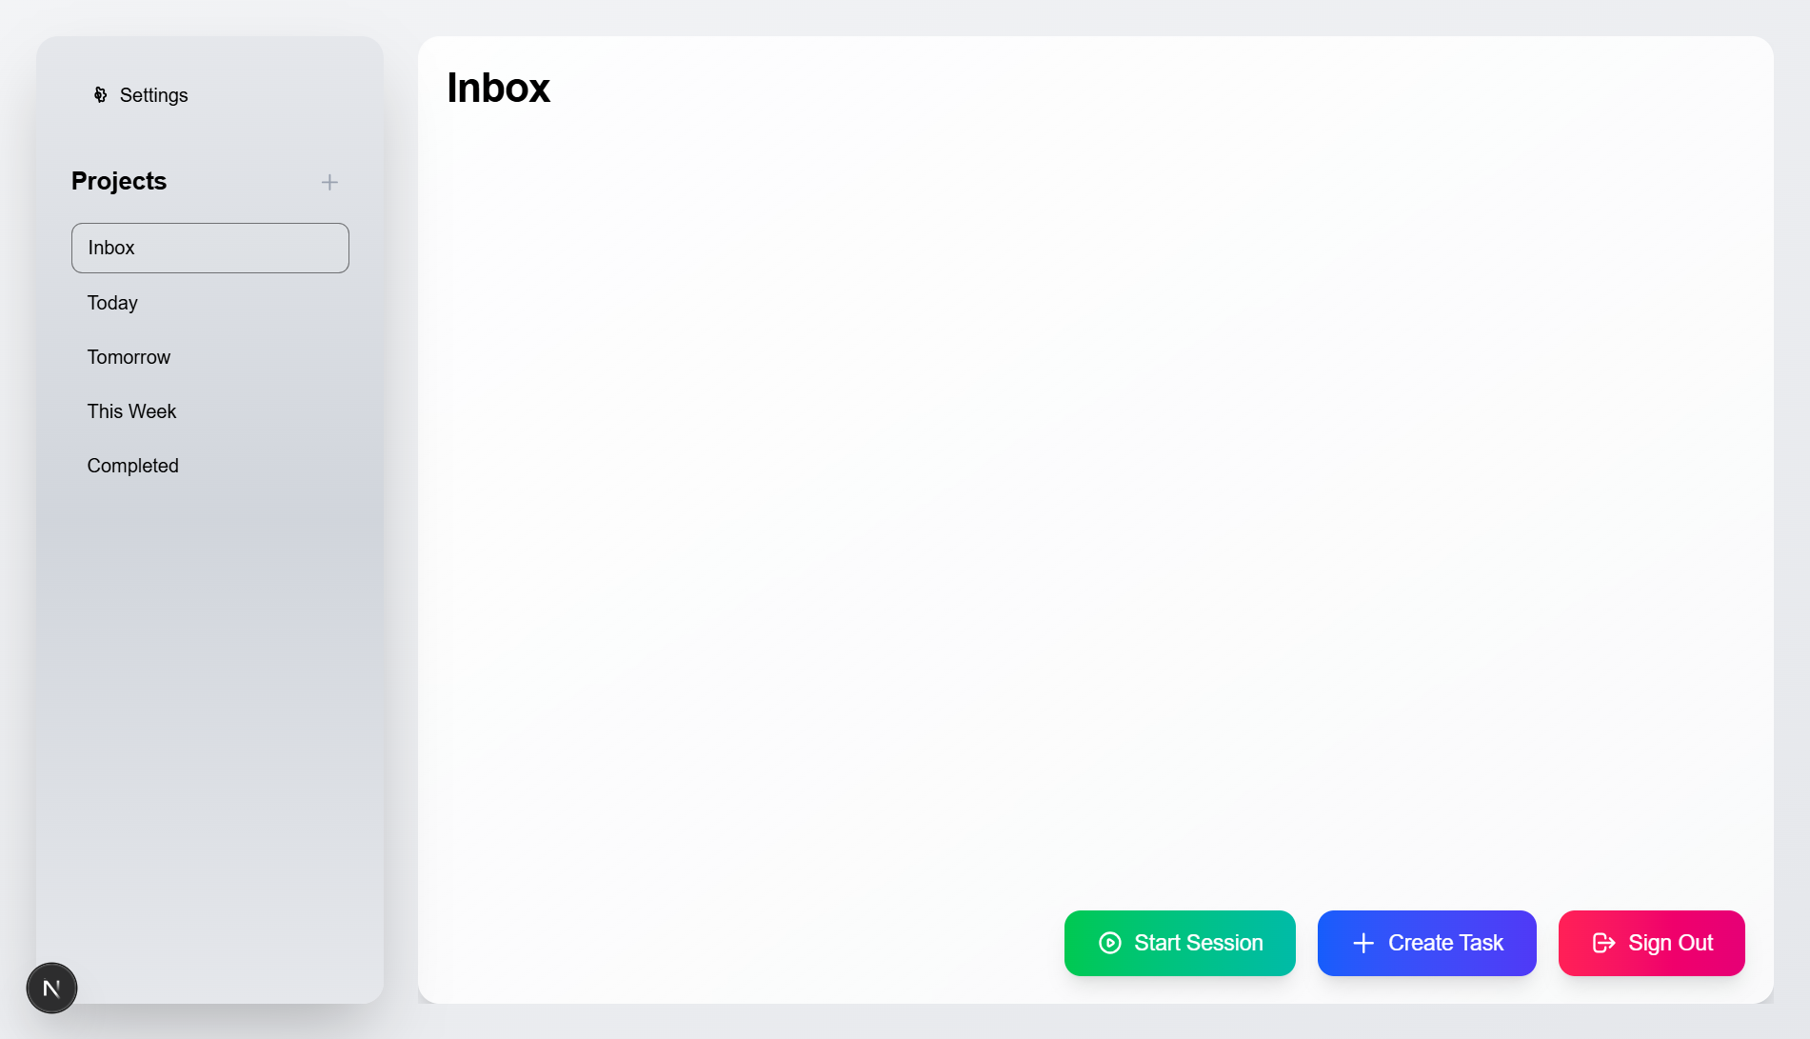
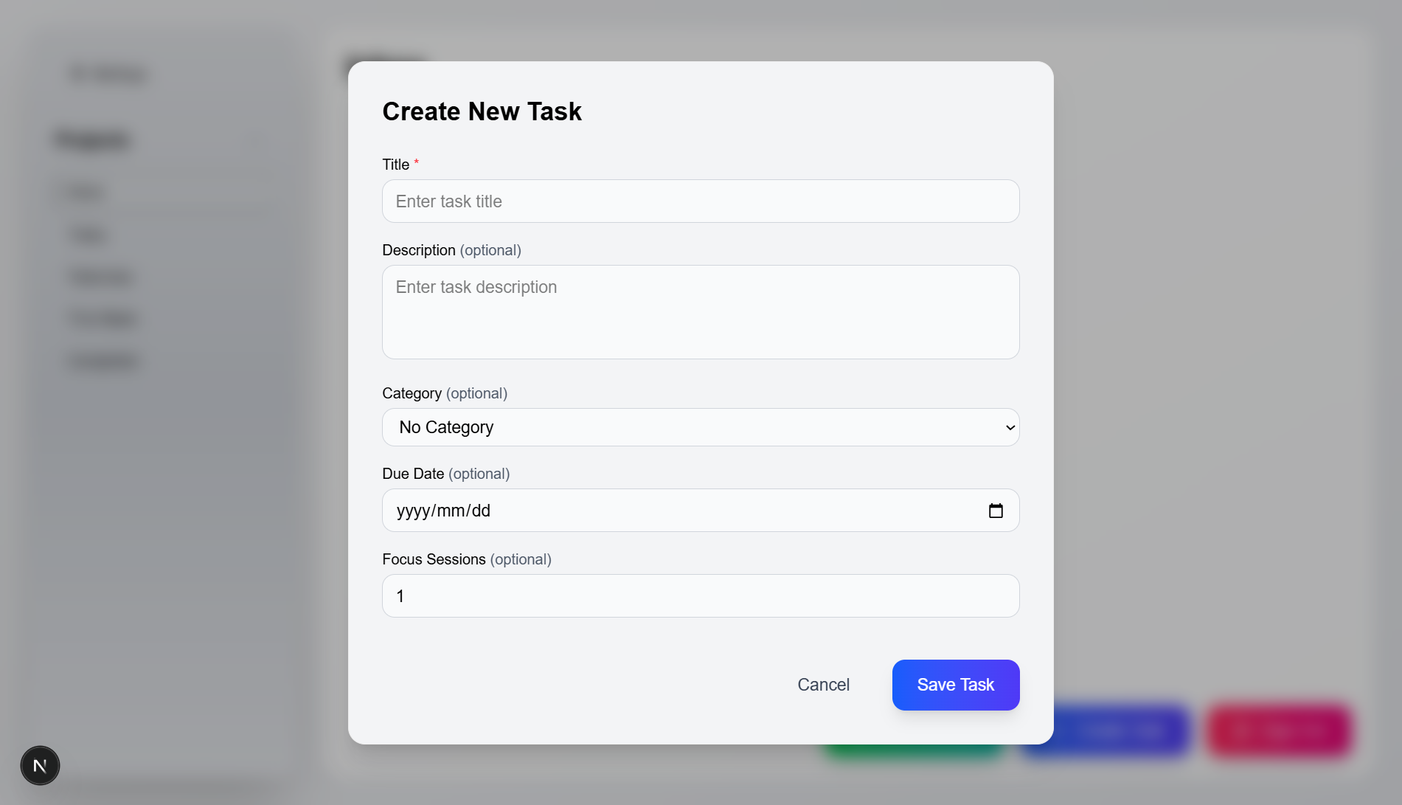
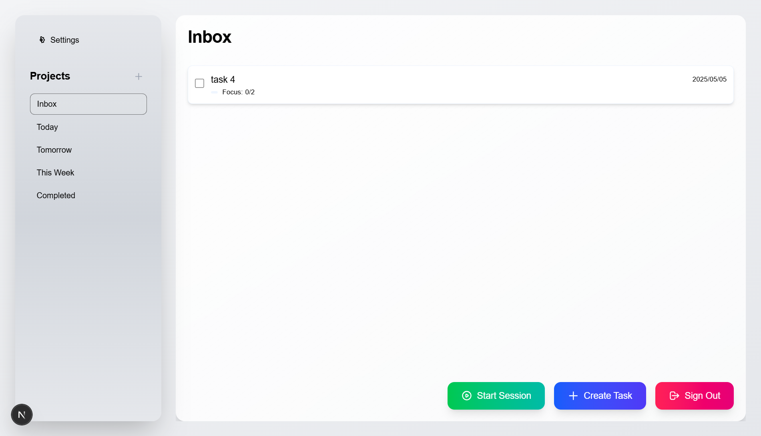
1
2
After user authentication, user is redirected to app main page, then user click create task button which opens a create new task dialog, after user fills the task data and clicks save task info the main page looks like that in image 3
3

Slide 7
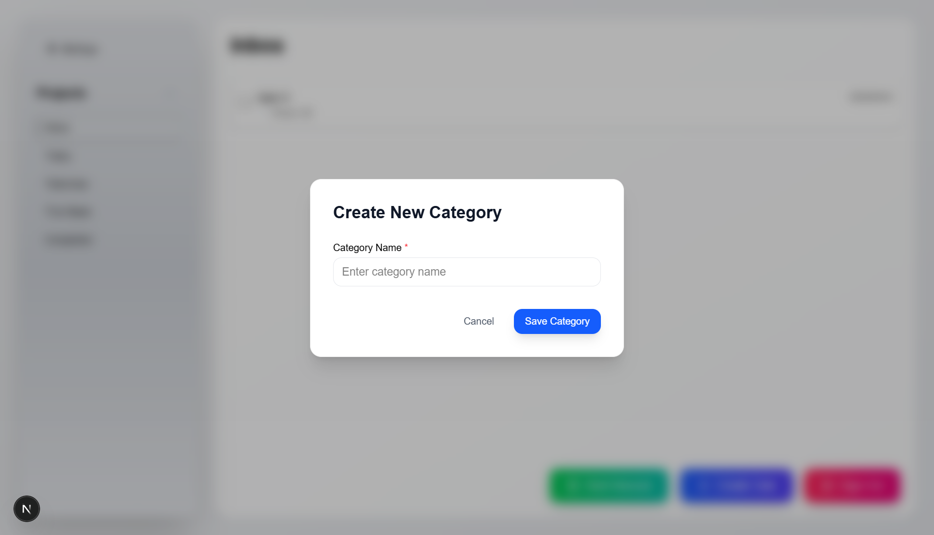
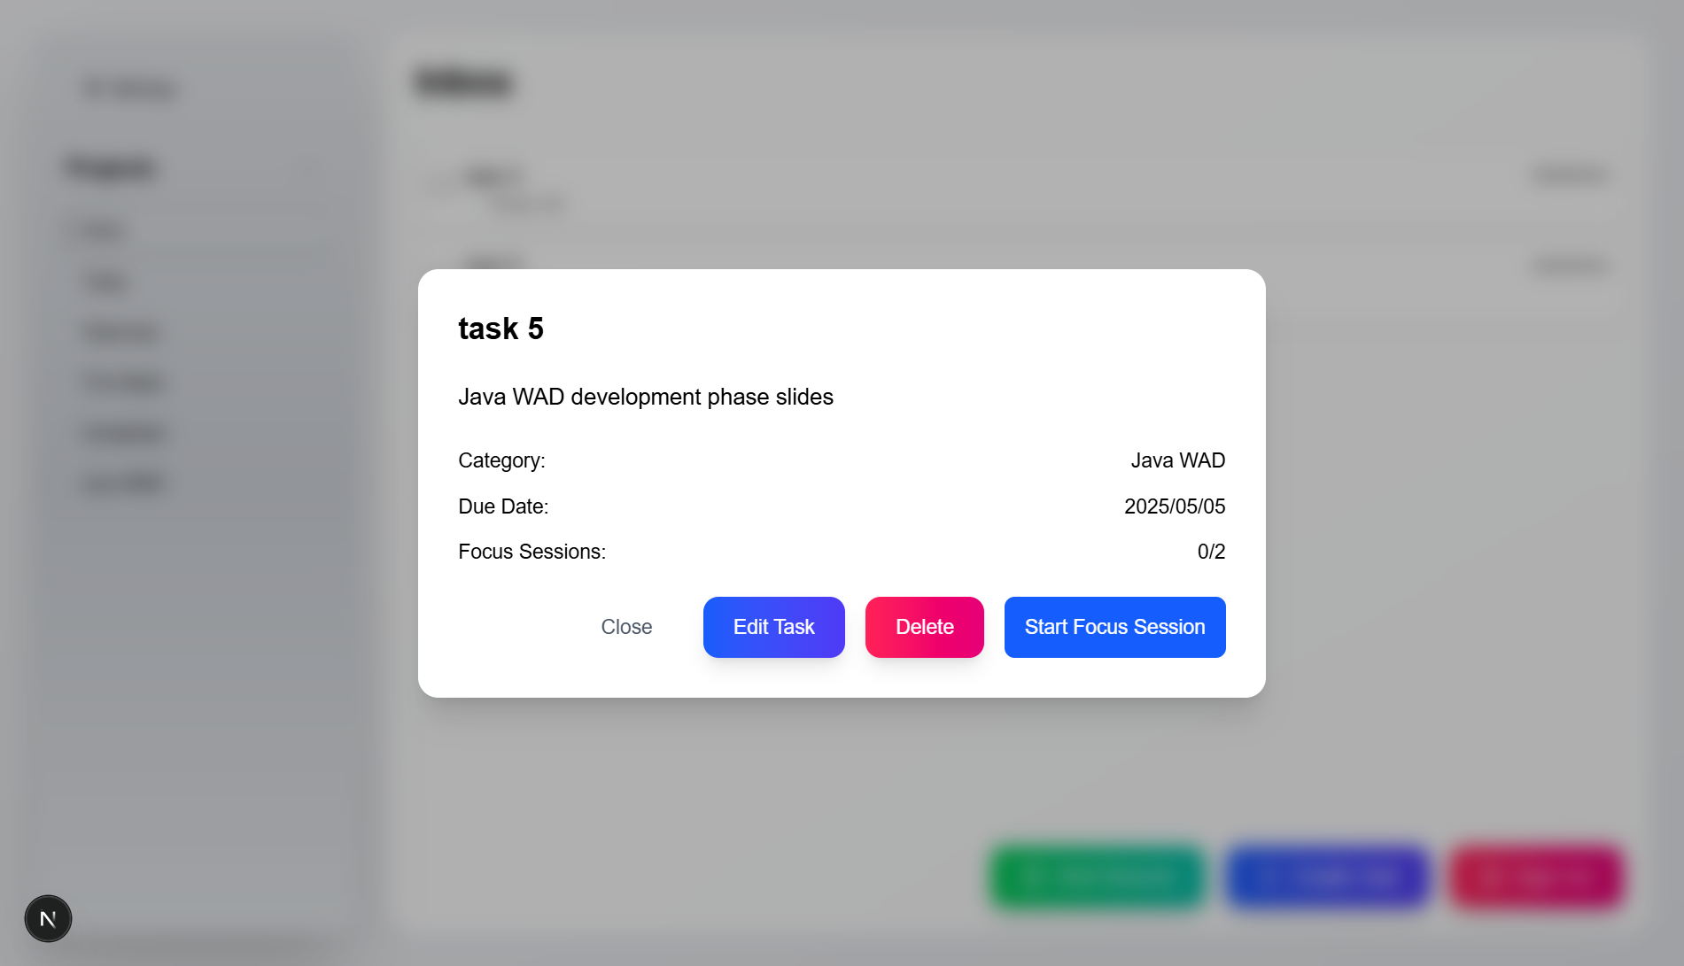
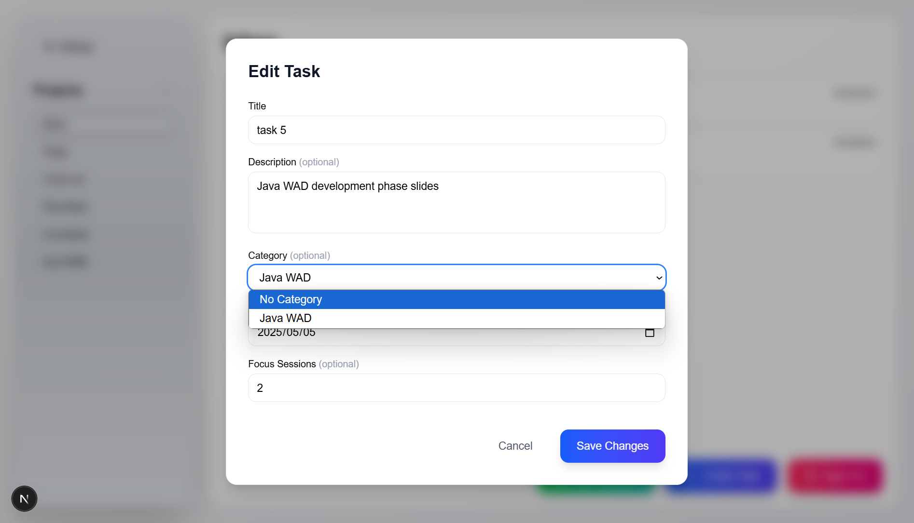
In the side menu a user can create new projects/categories to group his tasks. After creating a new category, a user can create a task and select that new category as the category of the task. And can edit old tasks to have the new categories

Slide 8
Changes
I decided not to add complex statistics at this time as I think the application is acceptable at this point in time for my own needs and adding more functionality will take focus away from the essential idea of the app.
Update: Added Cypress for testing:
login, category creation, editing, and deletion
login, category creation, task creation, editing, completion, and deletion.
Changed the architecture diagram, and added all iterations of created diagrams in doc_phase3 folder along with a video of the application.
Added mobile view changes.
Changed the readme file to include installation instructions, running instructions, testing instructions for cypress both from terminal and from GUI.
Changed the readme file to include usage instructions.

Slide 9
